Slide 1
Graphs and Their Applications

Slide 2
Content
History of Graph
Introduction to Graphs.
Basic Terminologies of Graphs.
Adjacency Matrix.
Graph Traversal: BFS.
Graph Traversal: DFS.

Slide 3
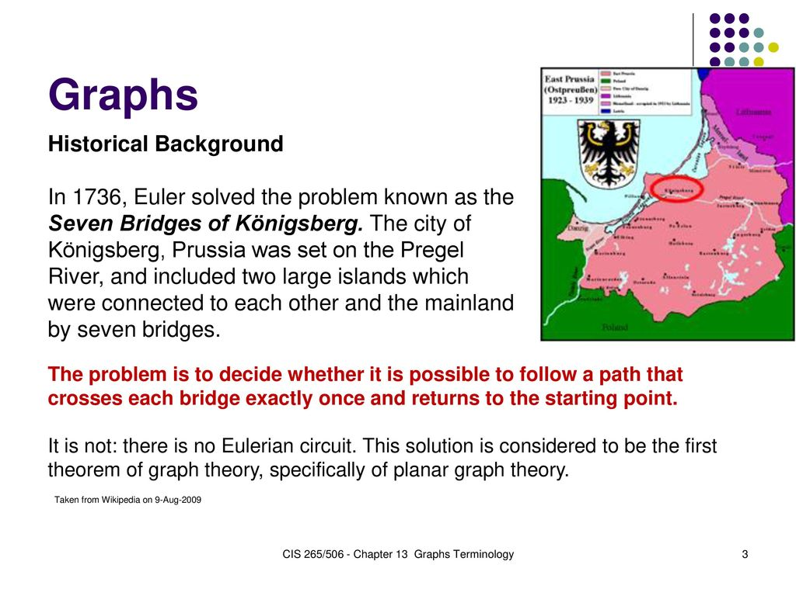
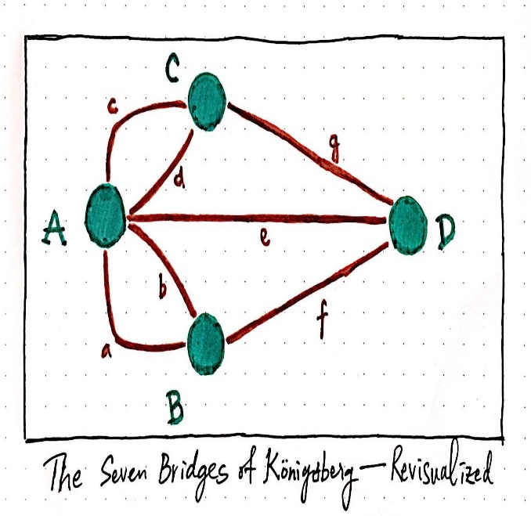
History of Graph

Slide 4
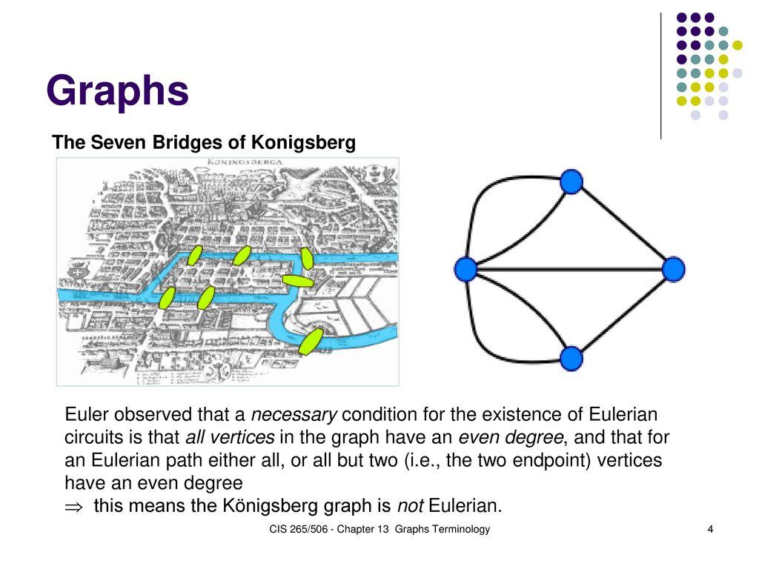
History of Graph (cont..)

Slide 5
Introduction to Graphs
A graph G = (V,E) is composed of:
V: set of vertices
E: set of edges connecting the vertices in V
An edge e = (u, v) is a pair of vertices
Example:
V={A, B, C, D, E}
E={(A,B), (A,D), (B,C),
(B,D), (C,D), (C,E),
(D,E)}
B
C
A
D
E

Slide 6
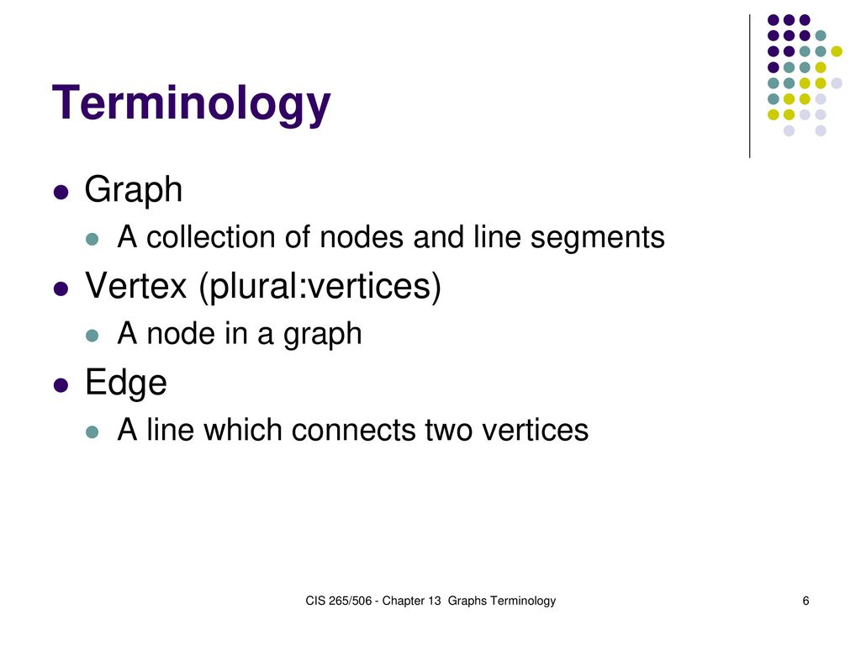

Slide 7
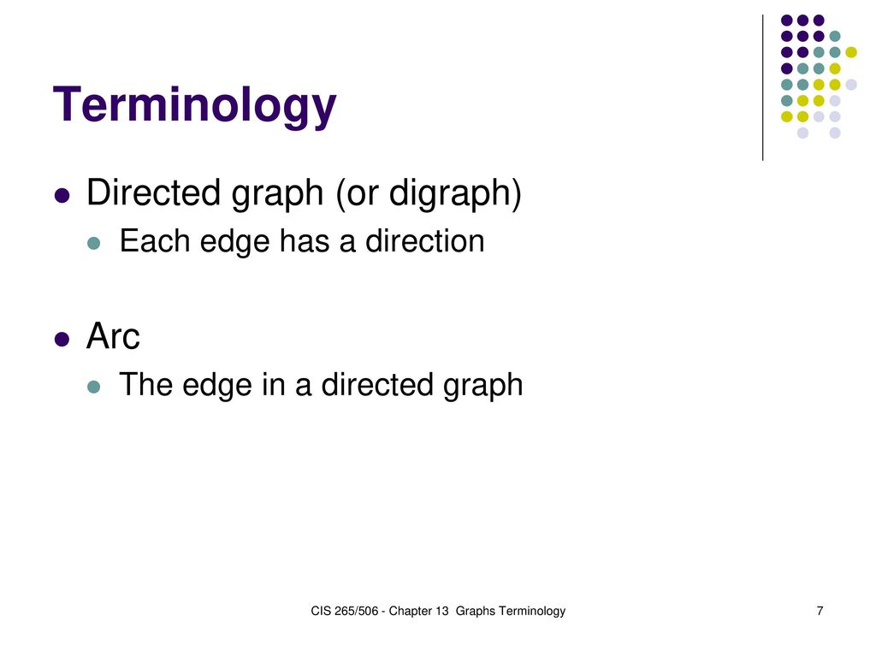

Slide 8
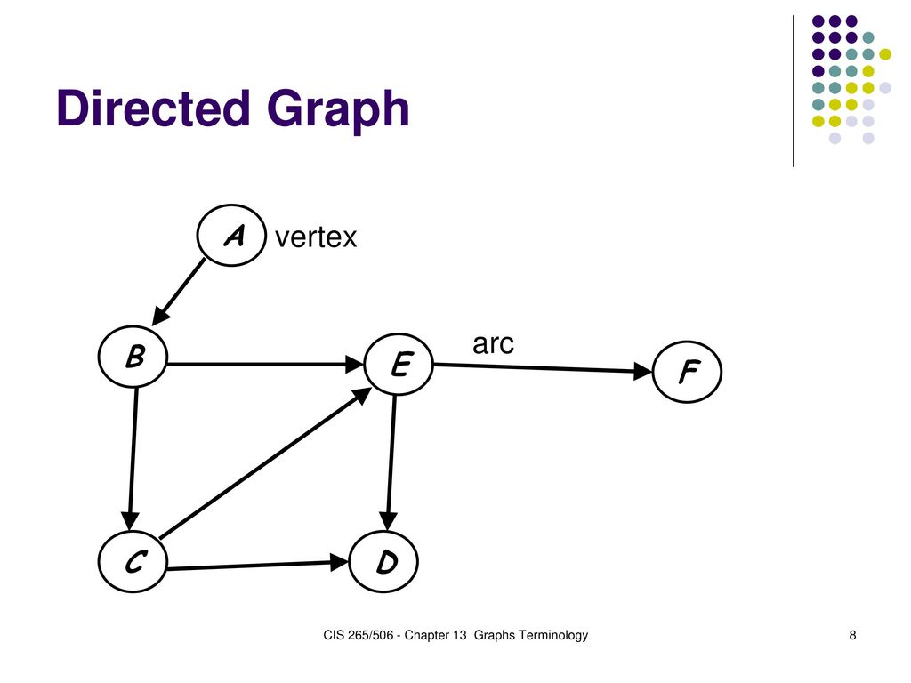

Slide 9
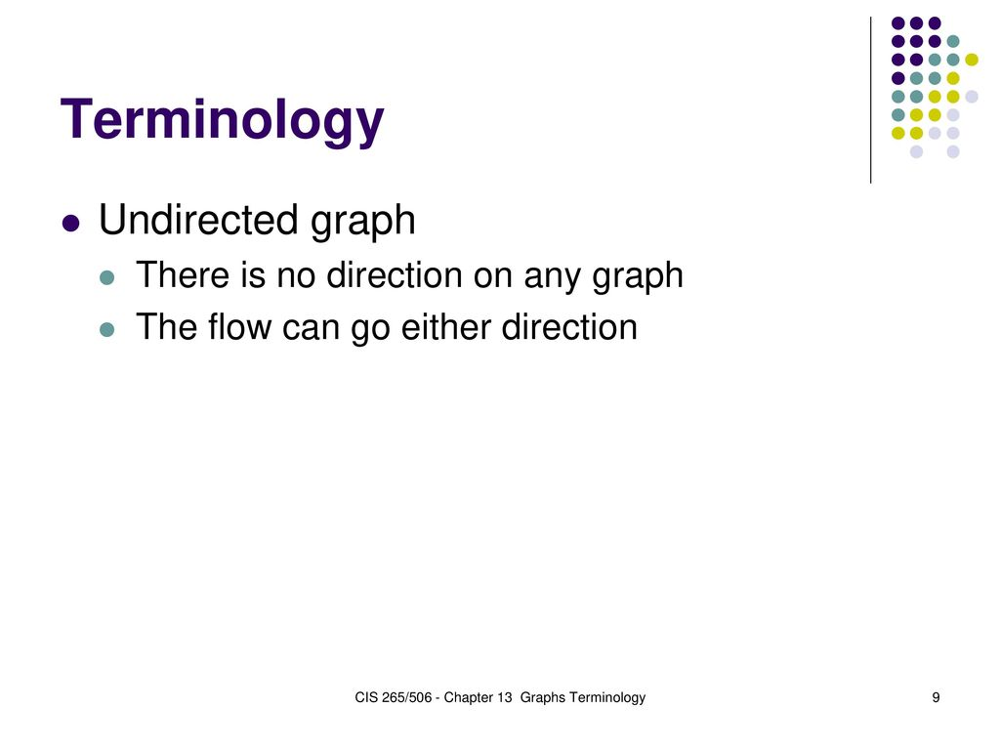

Slide 10
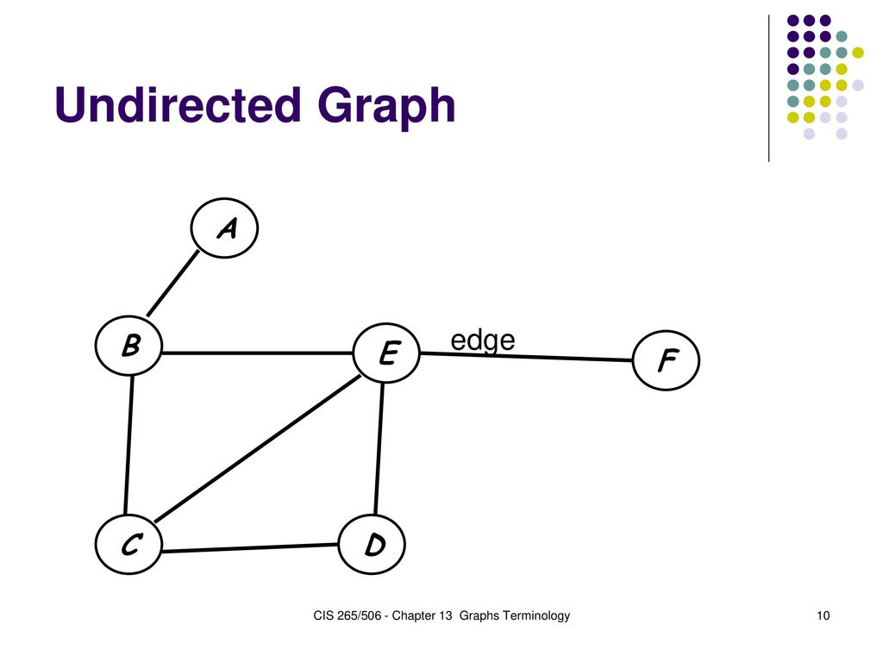

Slide 11
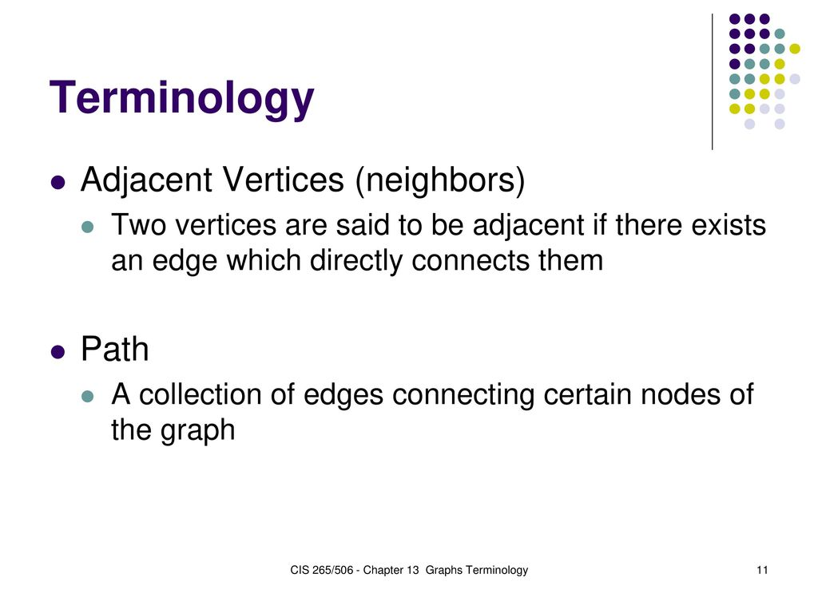

Slide 12
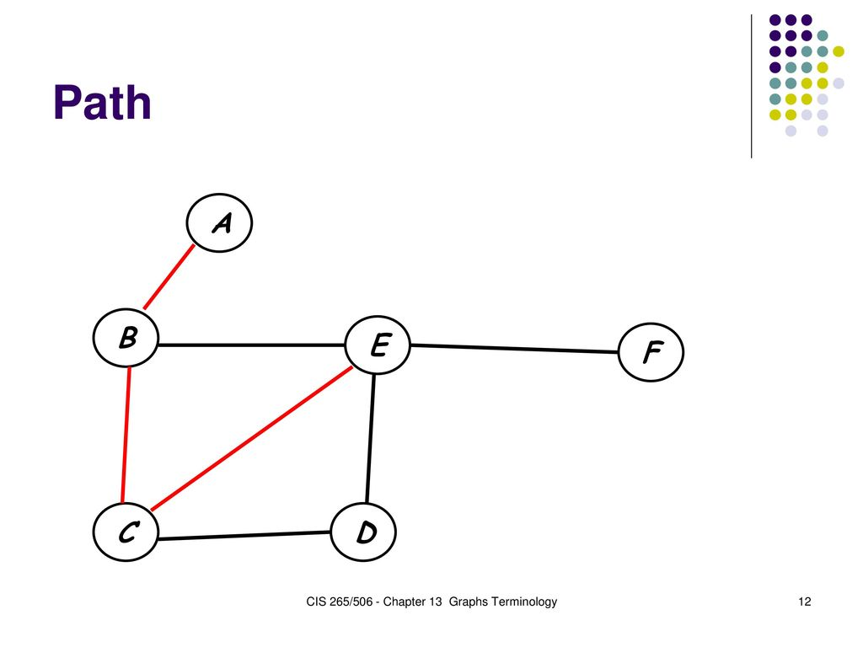

Slide 13
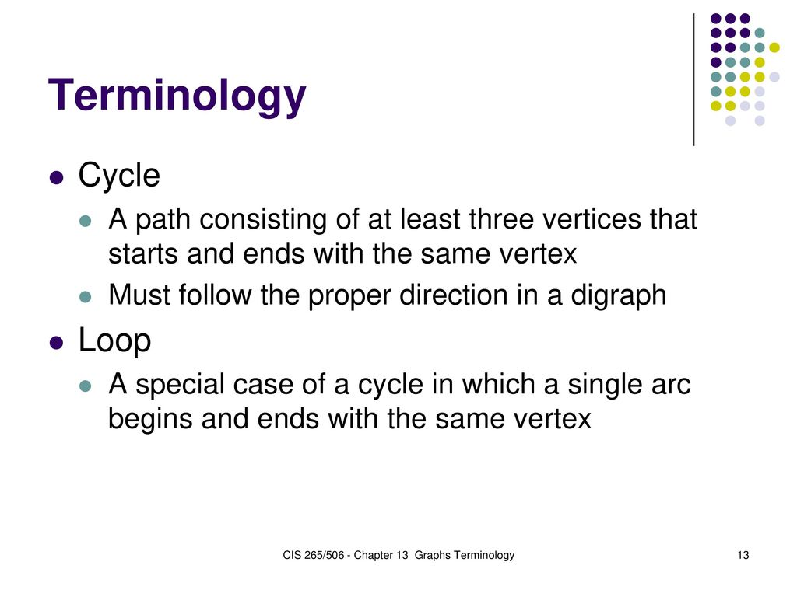

Slide 14
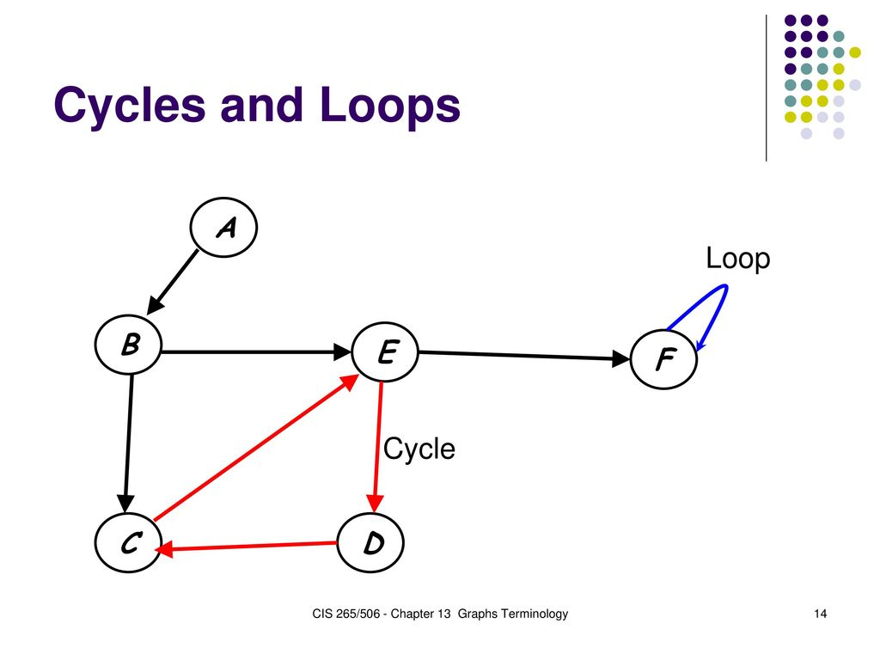

Slide 15
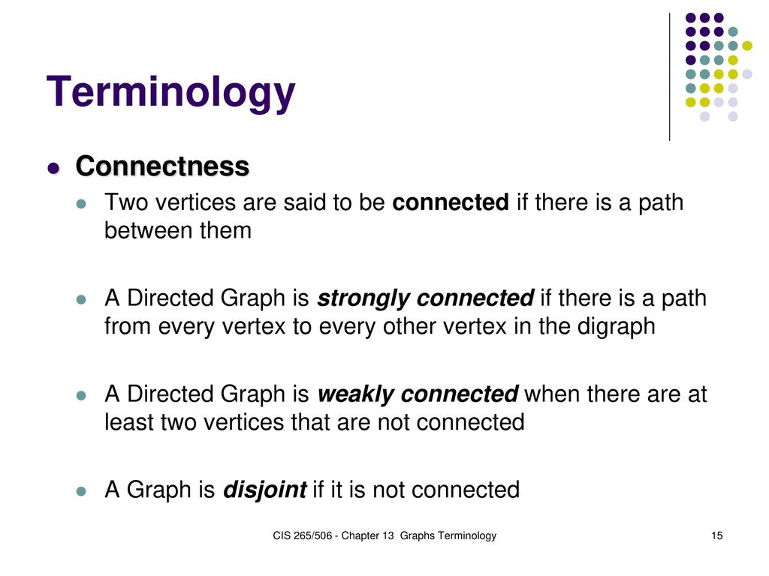

Slide 16
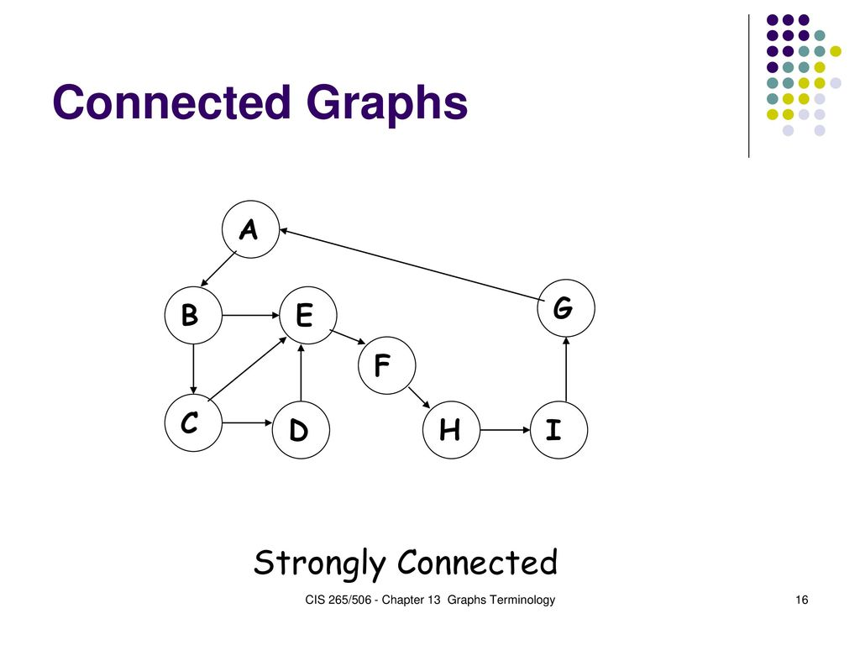

Slide 17
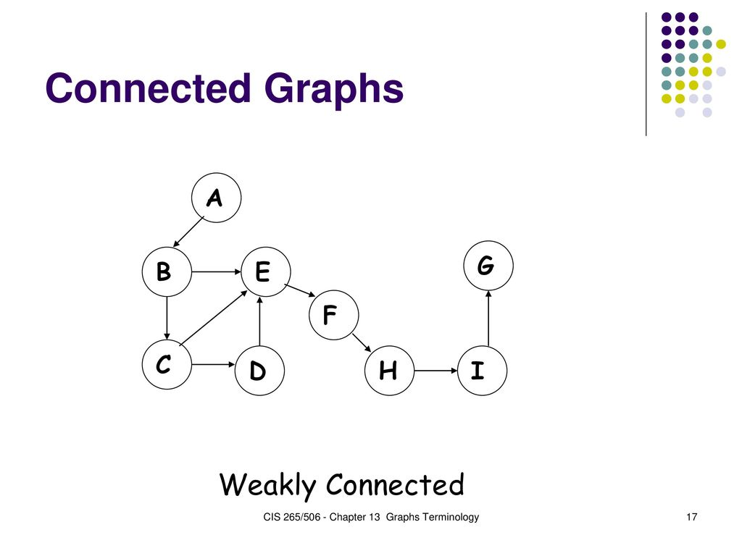

Slide 18
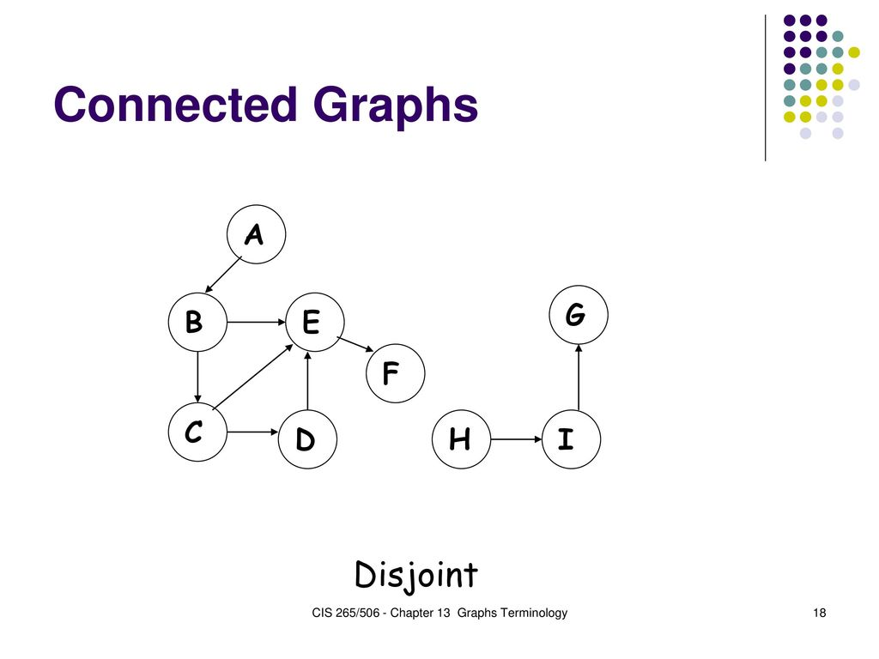

Slide 19
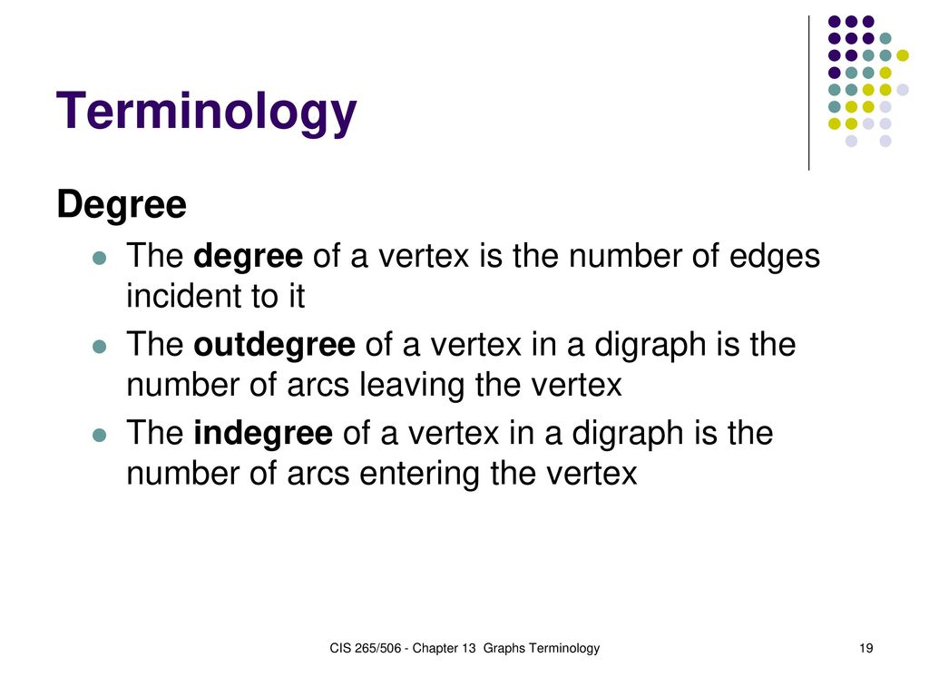

Slide 20
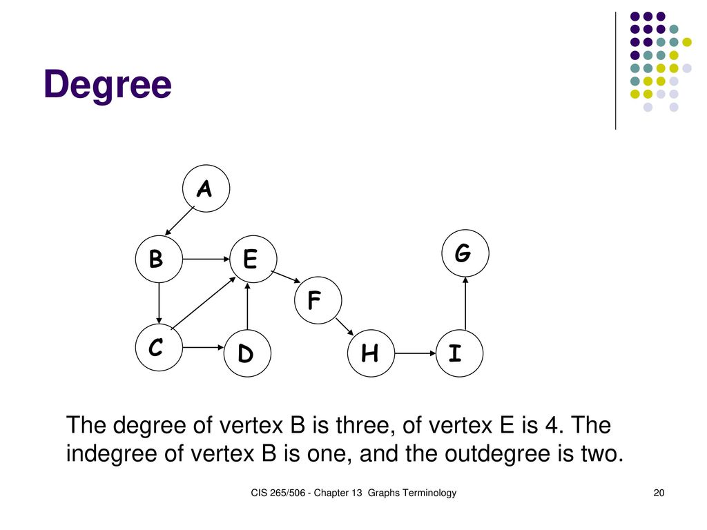

Slide 21
Adjacency Matrix
If G is a simple directed graph with m nodes, and the nodes of G have been ordered and are called v_{1,} v₂…v_{m}. Then the adjacency matrix A=(a_{ij}) of the graph G is the m × m matrix defined as,
1 if v_{i} is adjacent to v_{j}, that is there is an edge (v_{i}, v_{j})
a_{ij}=
0 otherwise
0 1 0 0
0 0 1 0
A= 1 0 0 1
0 1 0 0
A
B
C
D

Slide 22
Graph Traversal: BFS
Breadth First Search
A
Adjacency Lists
A | F | C | B
B | G | C
C | F
D | C
E | D | C | J
F | D
G | C | E
J | D | K
K | E | G
F
C
B
D
E
G
J
K

Slide 23
Graph Traversal: BFS
A->J
A
QUEUE | ORIG
A | Ø
F
C
B
D
E
G
J
K

Slide 24
Graph Traversal: BFS
A
QUEUE | ORIG
A | Ø
F | A
F
C
B
D
E
G
J
K

Slide 25
Graph Traversal: BFS
A
QUEUE | ORIG
A | Ø
F | A
C | A
F
C
B
D
E
G
J
K

Slide 26
Graph Traversal: BFS
A
QUEUE | ORIG
A | Ø
F | A
C | A
B | A
F
C
B
D
E
G
J
K

Slide 27
Graph Traversal: BFS
A
QUEUE | ORIG
A | Ø
F | A
C | A
B | A
D | F
F
C
B
D
E
G
J
K

Slide 28
Graph Traversal: BFS
A
QUEUE | ORIG
A | Ø
F | A
C | A
B | A
D | F
F
C
B
D
E
G
J
K

Slide 29
Graph Traversal: BFS
A
QUEUE | ORIG
A | Ø
F | A
C | A
B | A
D | F
G | B
F
C
B
D
E
G
J
K

Slide 30
Graph Traversal: BFS
A
QUEUE | ORIG
A | Ø
F | A
C | A
B | A
D | F
G | B
F
C
B
D
E
G
J
K

Slide 31
Graph Traversal: BFS
A
QUEUE | ORIG
A | Ø
F | A
C | A
B | A
D | F
G | B
E | G
F
C
B
D
E
G
J
K

Slide 32
Graph Traversal: BFS
A
QUEUE | ORIG
A | Ø
F | A
C | A
B | A
D | F
G | B
E | G
J | E
F
C
B
D
E
G
J
K

Slide 33
Graph Traversal: BFS
A
QUEUE | ORIG
A | Ø
F | A
C | A
B | A
D | F
G | B
E | G
J | E
K | J
F
C
B
D
E
G
J
K

Slide 34
Graph Traversal: BFS
A
QUEUE | ORIG
A | Ø
F | A
C | A
B | A
D | F
G | B
E | G
J | E
K | J
F
C
B
D
E
G
J
K

Slide 35
Graph Traversal: BFS
Path for A->J
A
QUEUE | ORIG
A | Ø
F | A
C | A
B | A
D | F
G | B
E | G
J | E
K | J
F
C
B
D
E
G
J
K

Slide 36
Graph Traversal: DFS
Depth First Search
A
Adjacency Lists
A | F | C | B
B | G | C
C | F
D | C
E | D | C | J
F | D
G | C | E
J | D | K
K | E | G
F
C
B
D
E
G
J
K

Slide 37
Graph Traversal: DFS
A->J
A
STACK | ORIG
A | Ø
F
C
B
D
E
G
J
K

Slide 38
Graph Traversal: DFS
A
STACK | ORIG
A | Ø
B | A
F
C
B
D
E
G
J
K

Slide 39
Graph Traversal: DFS
A
STACK | ORIG
A | Ø
B | A
G | B
F
C
B
D
E
G
J
K

Slide 40
Graph Traversal: DFS
A
STACK | ORIG
A | Ø
B | A
G | B
E | G
F
C
B
D
E
G
J
K

Slide 41
Graph Traversal: DFS
A
STACK | ORIG
A | Ø
B | A
G | B
E | G
D | E
F
C
B
D
E
G
J
K

Slide 42
Graph Traversal: DFS
A
STACK | ORIG
A | Ø
B | A
G | B
E | G
D | E
C | D
F
C
B
D
E
G
J
K

Slide 43
Graph Traversal: DFS
A
STACK | ORIG
A | Ø
B | A
G | B
E | G
D | E
C | D
F | C
F
C
B
D
E
G
J
K

Slide 44
Graph Traversal: DFS
A
STACK | ORIG
A | Ø
B | A
G | B
E | G
D | E
C | D
F | C
F
C
B
D
E
G
J
K

Slide 45
Graph Traversal: DFS
A
STACK | ORIG
A | Ø
B | A
G | B
E | G
D | E
C | D
F | C
F
C
B
D
E
G
J
K

Slide 46
Graph Traversal: DFS
A
STACK | ORIG
A | Ø
B | A
G | B
E | G
D | E
C | D
F | C
F
C
B
D
E
G
J
K

Slide 47
Graph Traversal: DFS
A
STACK | ORIG
A | Ø
B | A
G | B
E | G
D | E
C | D
F | C
J | E
F
C
B
D
E
G
J
K

Slide 48
Graph Traversal: DFS
A
STACK | ORIG
A | Ø
B | A
G | B
E | G
D | E
C | D
F | C
J | E
K | J
F
C
B
D
E
G
J
K

Slide 49
Graph Traversal: DFS
A
STACK | ORIG
A | Ø
B | A
G | B
E | G
D | E
C | D
F | C
J | E
K | J
F
C
B
D
E
G
J
K

Slide 50
Graph Traversal: DFS
A
STACK | ORIG
A | Ø
B | A
G | B
E | G
D | E
C | D
F | C
J | E
K | J
F
C
B
D
E
G
J
K

Slide 51
Graph Traversal: DFS
A
STACK | ORIG
A | Ø
B | A
G | B
E | G
D | E
C | D
F | C
J | E
K | J
F
C
B
D
E
G
J
K

Slide 52
Graph Traversal: DFS
A
STACK | ORIG
A | Ø
B | A
G | B
E | G
D | E
C | D
F | C
J | E
K | J
F
C
B
D
E
G
J
K

Slide 53
Graph Traversal: DFS
A
STACK | ORIG
A | Ø
B | A
G | B
E | G
D | E
C | D
F | C
J | E
K | J
F
C
B
D
E
G
J
K

Slide 54
Graph Traversal: DFS
A
STACK | ORIG
A | Ø
B | A
G | B
E | G
D | E
C | D
F | C
J | E
K | J
F
C
B
D
E
G
J
K

Slide 55
Graph Traversal: DFS
A
STACK | ORIG
A | Ø
B | A
G | B
E | G
D | E
C | D
F | C
J | E
K | J
F
C
B
D
E
G
J
K

Slide 56
Thanks

